Slide 1

A Context-Aware Smart City Information Portal for Intelligent Citizen Service Delivery and Public Engagement
Done By:
K. Goutham (192311169)
Ch. Bhargav Ram (192425334)
K. Phani Sridhar Yogi (192311091)
V. Venkata Kumar Reddy (192311350)
Gv. Maheshwar (192211653)
Guided By:
Dr. K. RajaGopal

Slide 2

INTRODUCTION
Cities generate large amounts of information and services.
Citizens often need multiple websites and applications to access these services.
Our project provides a single platform to access city information efficiently.
The portal improves communication between citizens and city authorities.

Slide 3
PROBLEM STATEMENT
Existing Issues
City information is scattered across multiple platforms.
Difficult to track complaints and service requests.
Lack of centralized emergency notifications.
Citizens spend time searching for important services.
Solution
Develop a Smart City Information Portal UI that provides all city-related services in one place.

Slide 4
MOTIVATION AND NEED
Motivation
Increase accessibility of public services.
Improve citizen satisfaction.
Reduce manual processes.
Need
One unified digital platform.
Faster complaint handling.
Personalized service recommendations.
Real-time updates and alerts.

Slide 5
OBJECTIVES
Provide a centralized city information platform for citizens.
Simplify access to public services and government resources.
Enable online complaint registration and tracking efficiently.
Deliver emergency alerts and city updates in real time.
Improve citizen engagement and convenience through digital services.
Facilitate quick communication between citizens and authorities.
Support informed decision-making using real-time information.

Slide 6
LITERATURE SURVEY
S. No | Author(s) | Year | Research Title | Methodology
1 | Zhang et al. | 2025 | AI-Based Smart City Service Delivery Framework | Artificial Intelligence
2 | Kumar & Singh | 2022 | Context-Aware Public Service Recommendation System | Machine Learning
3 | Lee et al. | 2024 | Intelligent Citizen Engagement Platform | Cloud Computing + IoT
4 | Ahmed et al. | 2023 | Smart City Information Portal Using IoT | IoT & Sensor Networks

Slide 7
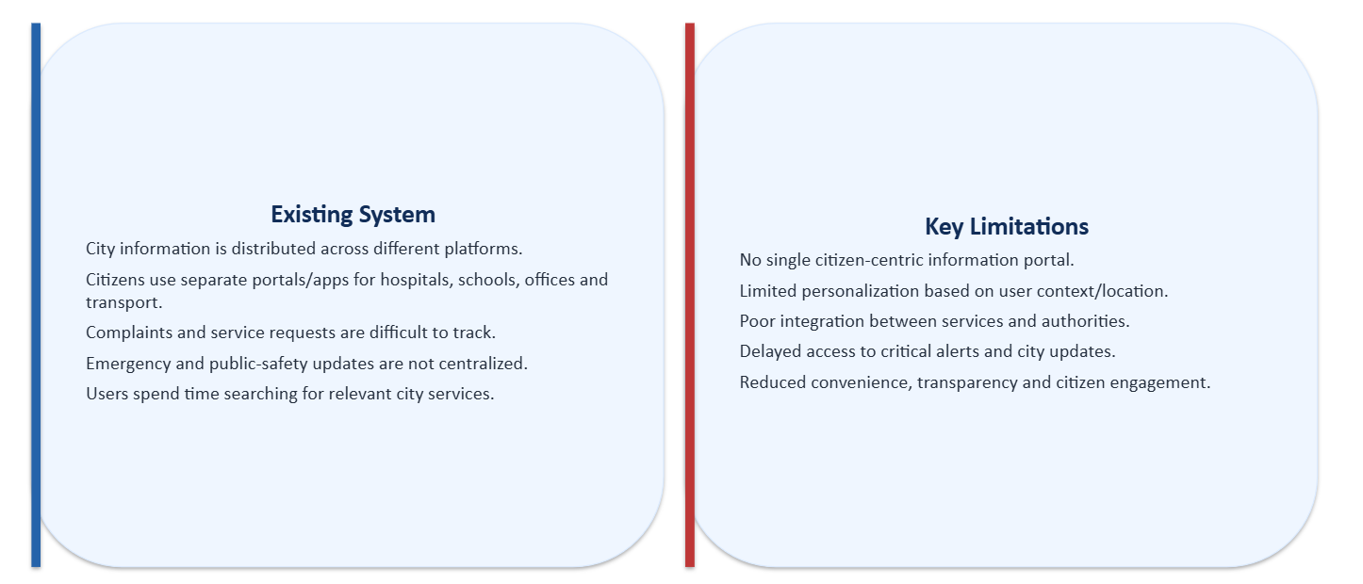
EXISTING AND LIMITATIONS

Slide 8
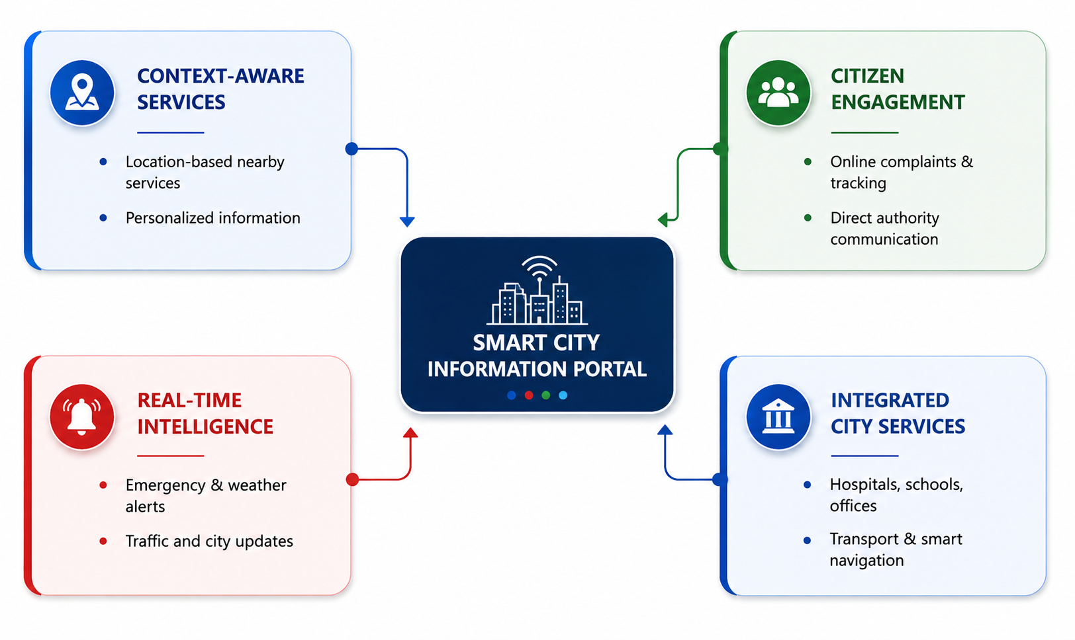
PROPOSED SYSTEM AND NOVEL FEATURES

Slide 9
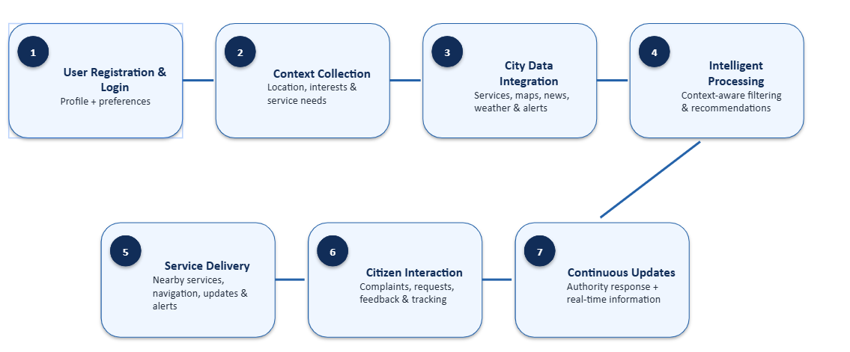
METHODOLOGY

Slide 10
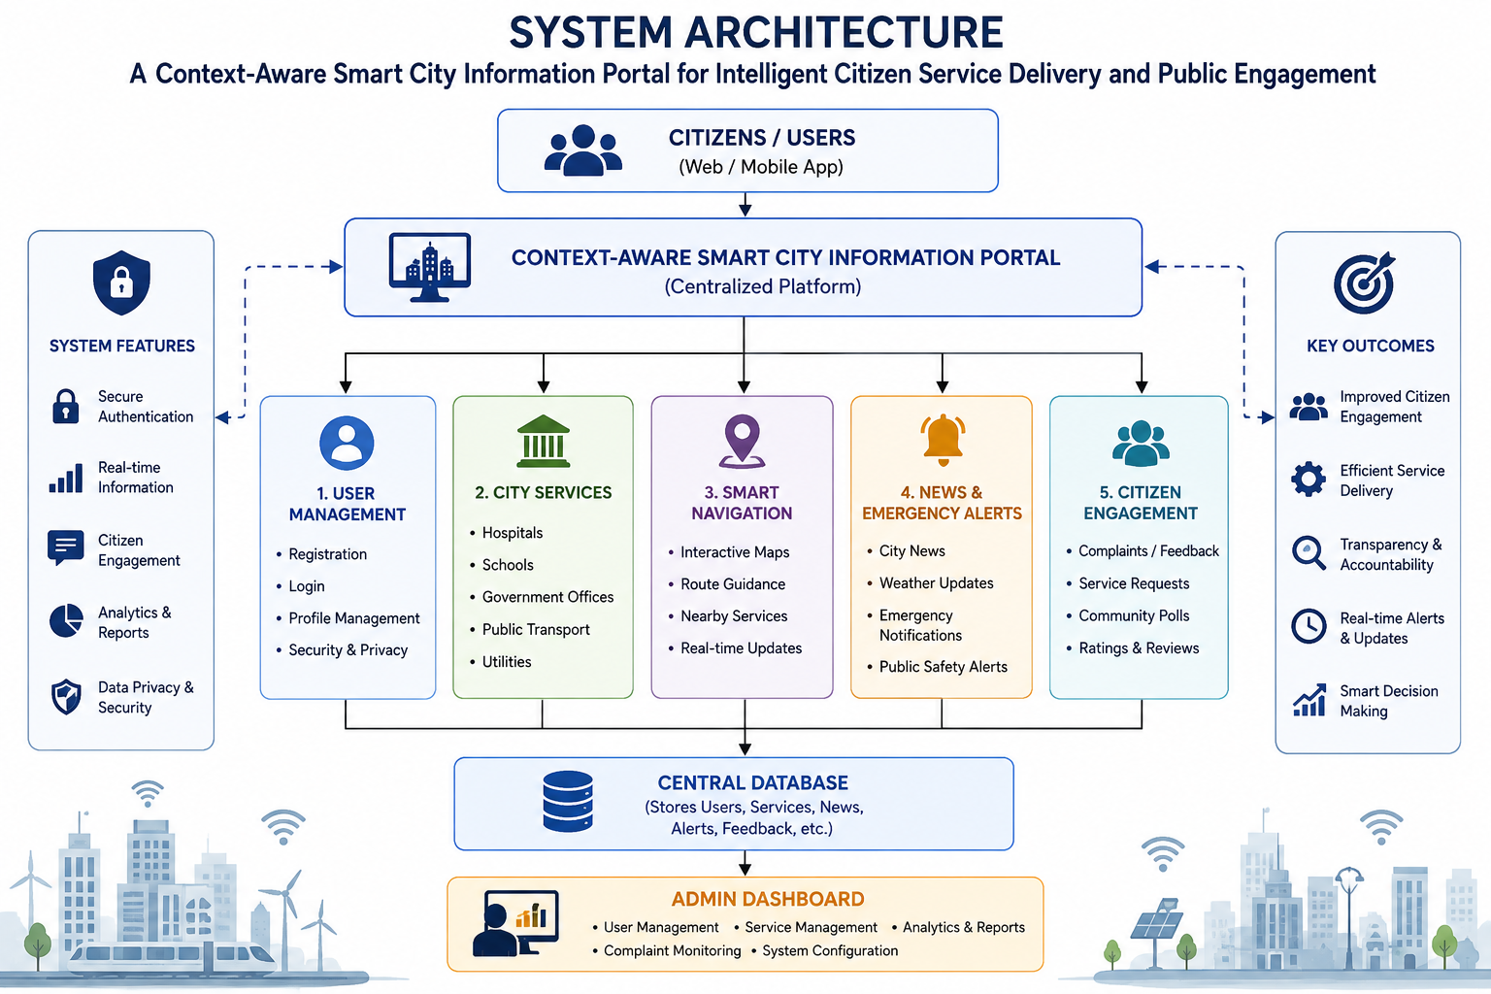
SYSTEM ARCHITECTURE

Slide 11
Technologies, Software & Hardware
Front-End
HTML5
CSS3
JavaScript
Back-End
PHP
Database
MySQL
Software
VS Code
XAMPP
phpMyAdmin
GitHub

Slide 12
System Modules
Module 1: User Management Module
Registration
Login
Profile management
Module 3: Smart Navigation
Interactive Maps
Root Guidance
Near by Services
Module 4: News and Emergency Alerts
City News
Weather Updates
Emergency Notifications
Module 2: City Services
Hospitals
Schools
Government Offices
Public Transport
Module 5:Citizens Feedback and Public Alert
Public Feedback
Complaints

Slide 13
Module 1: User Management
User Registration with secure account creation and validation process.
User Login using authenticated credentials for system access.
Profile Management for updating personal and contact information.
Password Recovery and account security through verification methods.

Slide 14
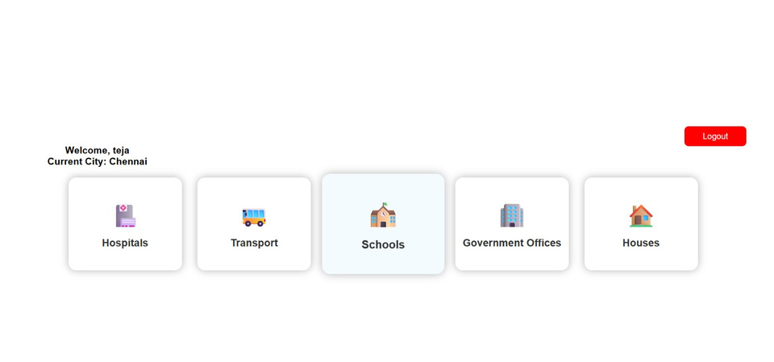
Module 2: City Services
Access detailed information about nearby hospitals and healthcare facilities.
View schools, colleges, and educational institution information easily.
Locate government offices and access public service information.
Check public transport routes, schedules, and travel details.

Slide 15
Module 3:Smart Navigation
Interactive maps for efficient city-wide navigation and exploration.
Route guidance with optimized directions for faster travel.
Discover nearby services based on user location preferences.
Receive real-time traffic updates and navigation assistance.

Slide 16
Module 4: News & Emergency Alerts
Access the latest city news and public announcements.
Receive real-time weather updates and forecast information.
Get emergency notifications during critical city situations.
View public safety alerts and disaster management updates.

Slide 17
Module 5: Citizen Feedback and Public Alert Management
Complaint & Feedback Registration – Citizens can submit complaints, suggestions, and service feedback online.
Complaint Status Tracking – Users can track the progress and resolution status of submitted complaints.
Citizen Polls & Surveys – Conduct polls and surveys to understand public opinions and community needs.
Public Engagement & Notifications – Enable citizens to participate in discussions and receive updates from city authorities.

Slide 18
CONCLUSION
Provides a centralized platform for accessing city information and services.
Simplifies citizen interaction with government departments and authorities.
Enhances public service delivery through digital and intelligent solutions.
Supports efficient complaint registration and tracking mechanisms.
Improves citizen engagement, transparency, and urban governance.
Delivers real-time updates, emergency alerts, and public information.

Slide 19
FUTURE SCOPE
Integrate Artificial Intelligence for personalized citizen recommendations.
Implement chatbot support for instant query resolution and assistance.
Add IoT-based smart city monitoring and real-time data collection.
Enable multilingual support for wider citizen accessibility.
Incorporate online payment facilities for municipal services.
Develop a mobile application for improved user convenience.

Slide 20


